Slide 1
Outline
Motivation
Problem Statement
Challenges
Related Work
Contributions
Validation
Theoretical analysis
Experimental evaluation
Case studies
Conclusion

Slide 2
Validation – Correctness and Completeness of ASP_FMGT_Mono
Theorem: ASP_FMGT_Mono is correct
Proof is based on the following lemmas:
Paths in the refine phase must be simple paths
Every step in recursive enumeration checks whether a node has been visited
All paths in the refine phase are paths in the original graph
No new edges are made
Theorem: ASP_FMGT_Mono is complete
Proof is based on the following lemmas:
FMG-trees cover all the simple paths on the original network
Any simple path must be one of the following case:
(1) within an FMG-node
(2) represented as a concatenation of FMG-nodes
All concatenations are exhaustively enumerated as FMG-paths
The upper-bound density does not underestimate the density of paths
The refine phase does not miss any path that survive the prune phase

Slide 3
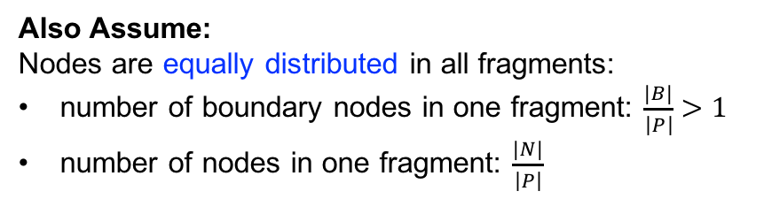
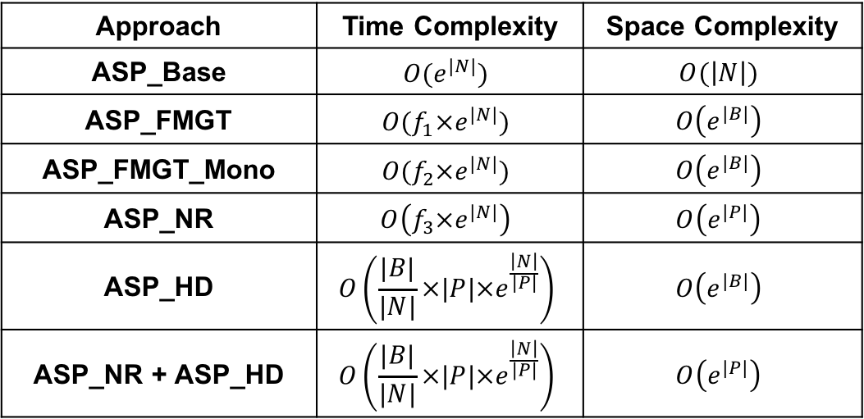
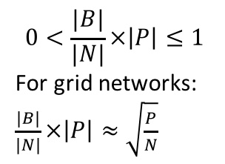
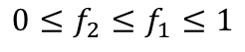
Validation – time and space complexities
Given:
|N| nodes (edges)
|P| fragments
|B| total boundary nodes
where: |P| << |N|, and |B| << |N|
Also Assume:
Nodes are equally distributed in all fragments:
number of boundary nodes in one fragment: $\frac{|B|}{\left|P\right|}>1$
number of nodes in one fragment: $\frac{|N|}{\left|P\right|}$
Approach | Time Complexity | Space Complexity
ASP_Base | $$O(e^{|N|})$$ | $$O(\left|N\right|)$$
ASP_FMGT | $${O(f}_{1}×e^{|N|})$$ | $$O\left(e^{|B|}\right)$$
ASP_FMGT_Mono | $${O(f}_{2}×e^{|N|})$$ | $$O\left(e^{|B|}\right)$$
ASP_NR | $$O\left(f_{3}×e^{|N|}\right)$$ | $$O\left(e^{|P|}\right)$$
ASP_HD | $$O\left(\frac{|B|}{|N|}×|P|×e^{\frac{\left|N\right|}{|P|}}\right)$$ | $$O\left(e^{|B|}\right)$$
ASP_NR + ASP_HD | $$O\left(\frac{|B|}{|N|}×|P|×e^{\frac{\left|N\right|}{|P|}}\right)$$ | $$O\left(e^{|P|}\right)$$
$$0≤f_{2}≤f_{1}≤1$$
$$0<\frac{|B|}{|N|}×\left|P\right|≤1$$
For grid networks:
$\frac{|B|}{|N|}×\left|P\right|≈\sqrt{\frac{P}{N}}$
Lemmas:
1: All proposed approaches have less time complexity than ASP_Base
2: ASP_FMGT_Mono has less time complexity than ASP_FMGT
3: ASP_HD and ASP_NR+ASP_HD have less time complexity than ASP_FMGT_Mono
4: ASP_NR and ASP_NR+ASP_HD have less space complexity than
ASP_FMGT, ASP_FMGT_Mono, and ASP_HD

Slide 4
Outline
Motivation
Problem Statement
Challenges
Related Work
Contributions
Validation
Theoretical analysis
Experimental evaluation
Case studies
Conclusion

Slide 5
Validation – Experiment setup
Candidates:
Approaches that guarantee correctness and completeness: ASP_Base, ASP_FMGT, and ASP_FMGT_Mono
Approaches that guarantee correctness: ASP_NR, ASP_HD, and ASP_NR + ASP_HD
Metric - Run time (CPU time), Solution quality
Platform - Java, Intel i7 2.5 GHz CPU, 16 GB RAM
Data: Synthetic data:
Random activities on grid networks with tuned width, height, and percentage of 2-degree nodes
We set 95% of the nodes 2-degree which complies with the real world dataset
Example grid network
width = 7
height = 4
% of 2-degree nodes = 71.4%

Slide 6
Validation – experimental goals
Candidates:
Approaches that guarantee correctness and completeness: ASP_Base, ASP_FMGT, and ASP_FMGT_Mono
Approaches that guarantee correctness: ASP_NR, ASP_HD, and ASP_NR + ASP_HD
Goals
Comparative analysis by answering:
How do proposed approaches perform compared to Baseline approaches?
Sensitivity analysis by answering:
How are proposed affected by varied network size?
How are proposed affected by varied number of partitions?
How are proposed affected by varied number of activities?
How are proposed affected by varied density threshold?
Synthetic Datasets
Network size
Variables
Number of partitions
Comparative and Sensitivity analyses
Simulator
Number of activities
Density threshold
ASP_Base
ASP_FMGT
ASP_FMGT_Mono
ASP_NR
ASP_HD

Slide 7
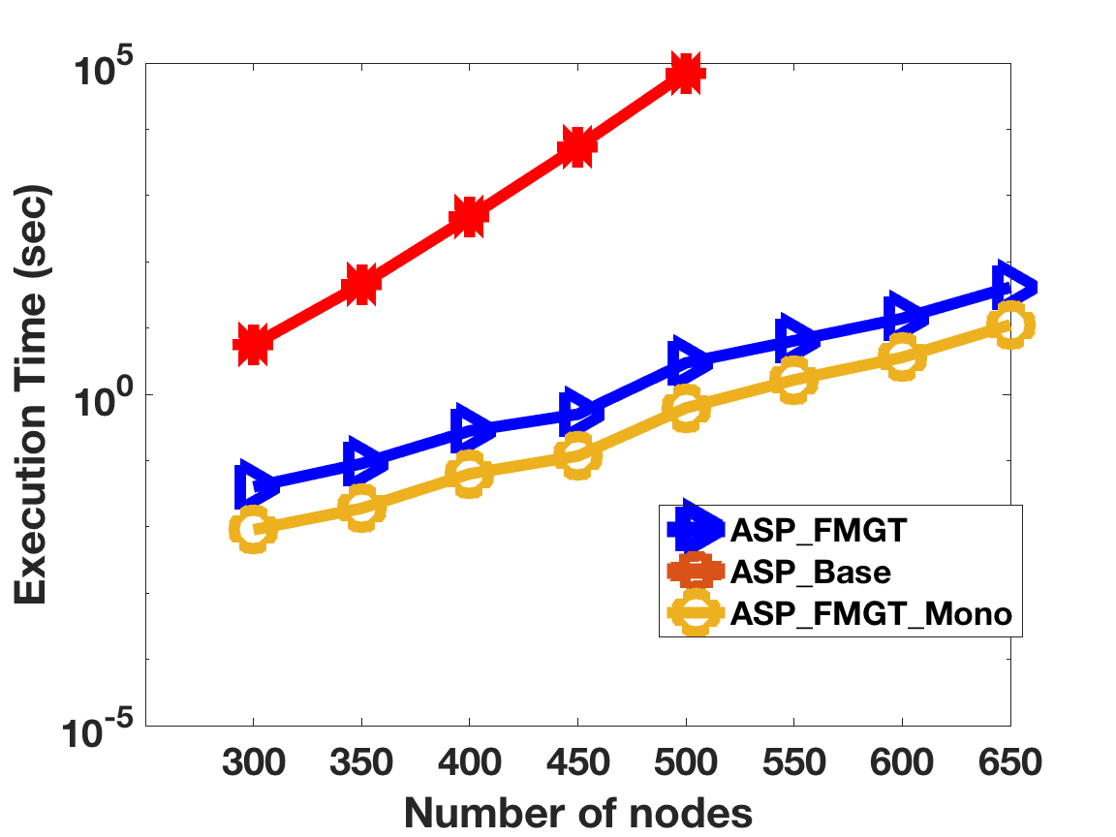
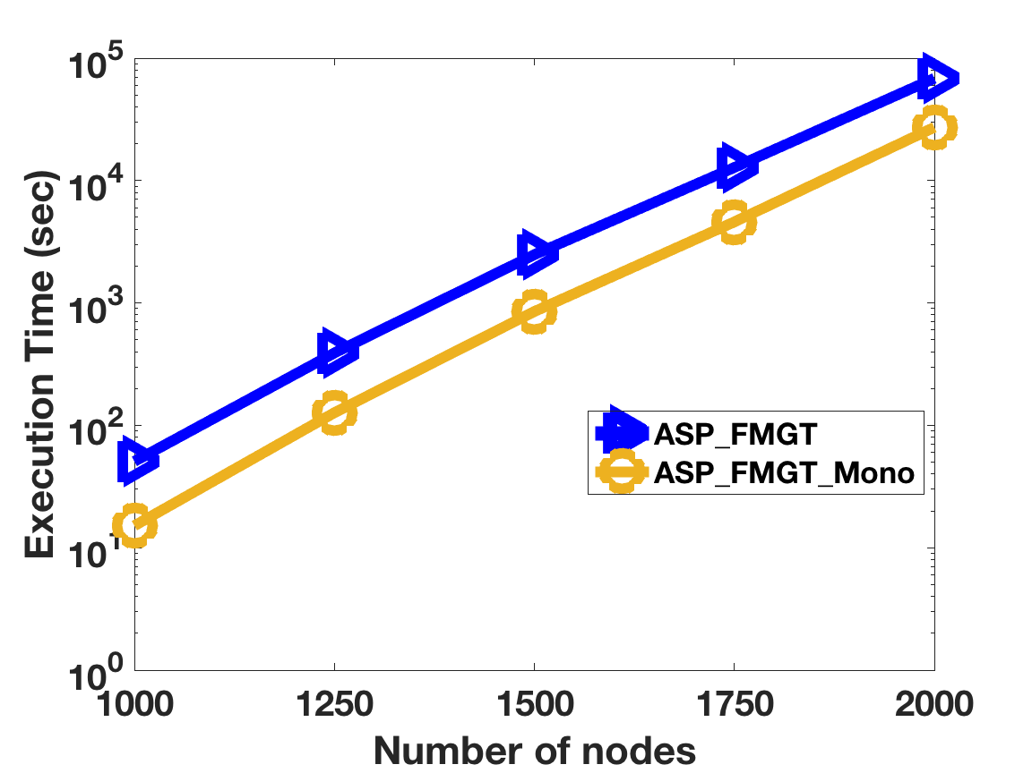
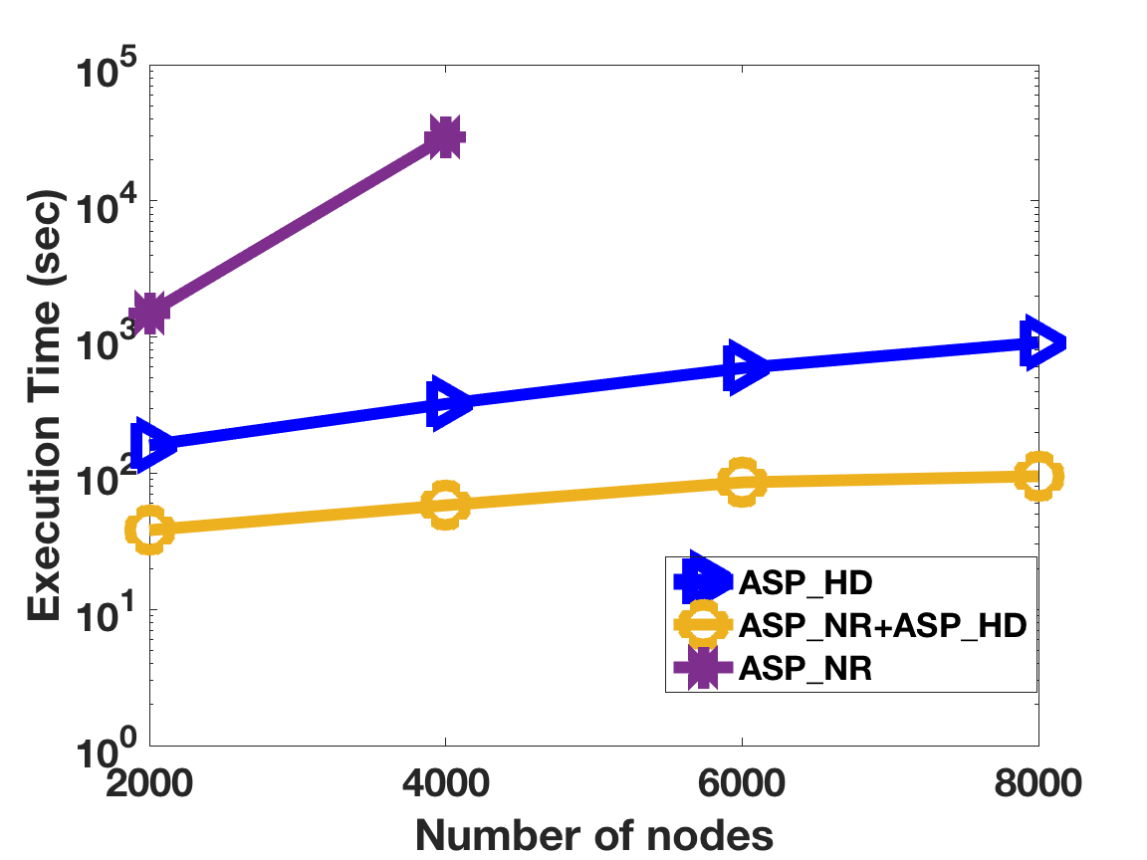
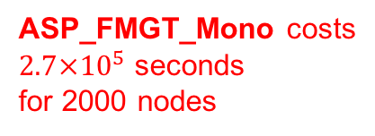
Comparative analysis: How do proposed approaches perform compared to Baseline approaches?
Fixed Parameters:
Activity density (activity per edge in average): 0.01
Density threshold = 1
Number of Partitions = 50
Varied parameter: Number of nodes
~3% simple paths are enumerated by ASP_NR + ASP_HD
ASP_FMGT_Mono costs
$2.7×{10}^{5}$ seconds
for 2000 nodes
Trends:
ASP_Base reaches unacceptable cost very fast.
ASP_FMGT and ASP_FMGT_Mono are up to ~10⁴ times faster than ASP_Base
Cost of ASP_FMGT_Mono is about 2~4 times faster than ASP_FMGT
Cost of ASP_NR + ASP_HD is ~100x faster than ASP_FMGT_Mono
ASP_FMGT_Mono

Slide 8
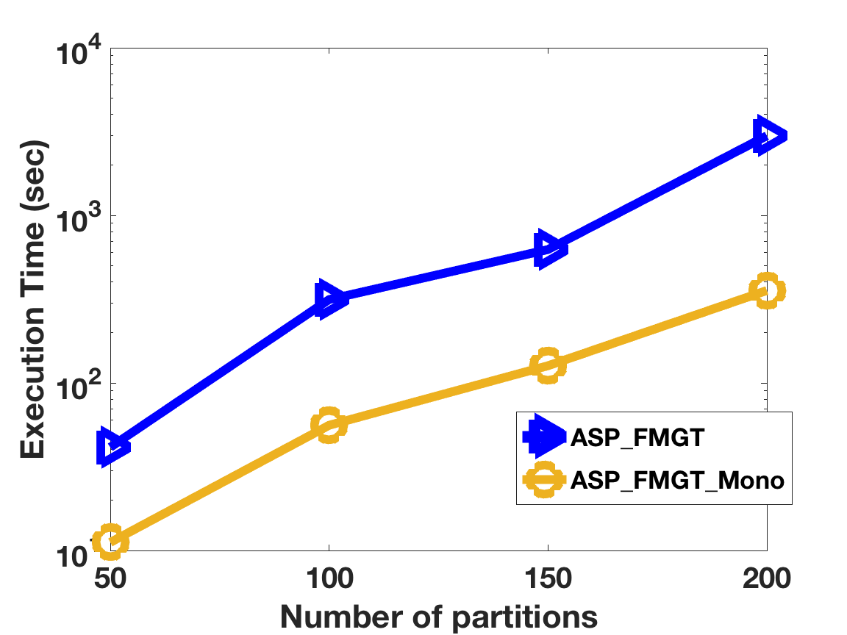
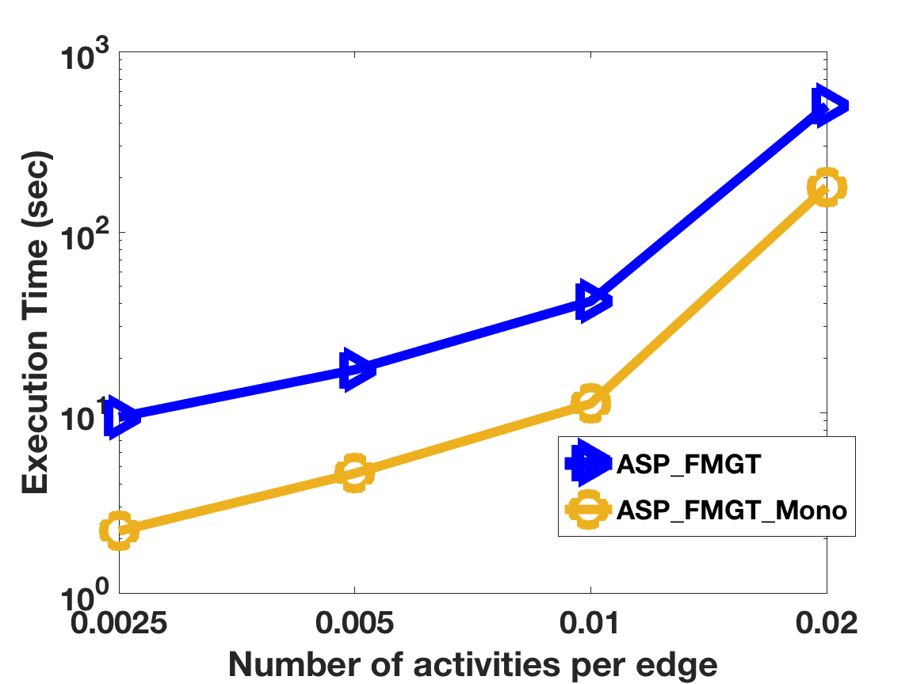
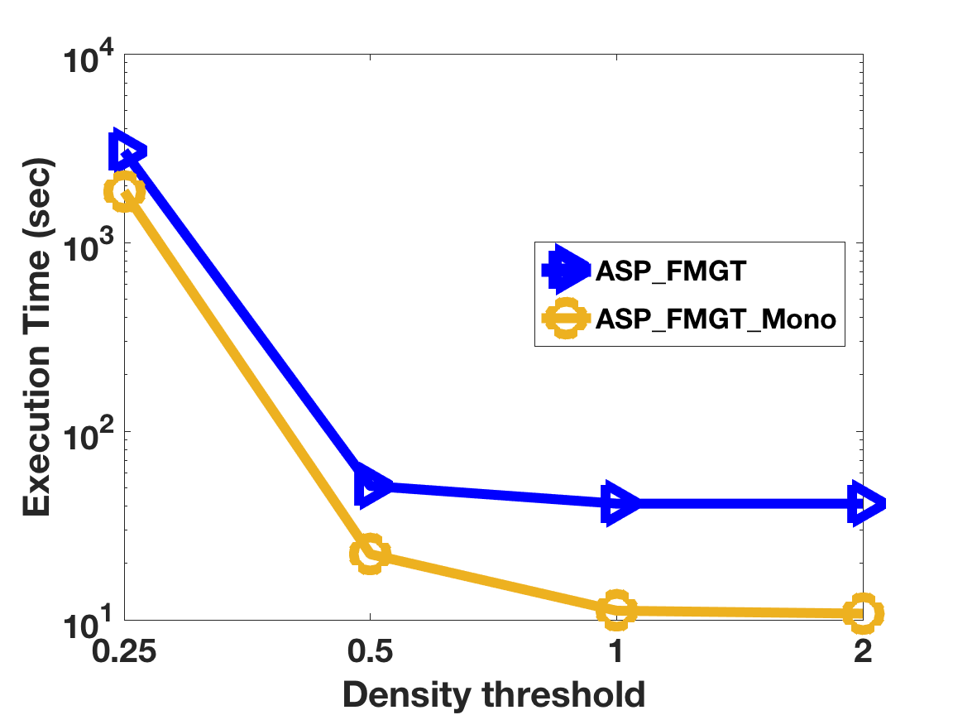
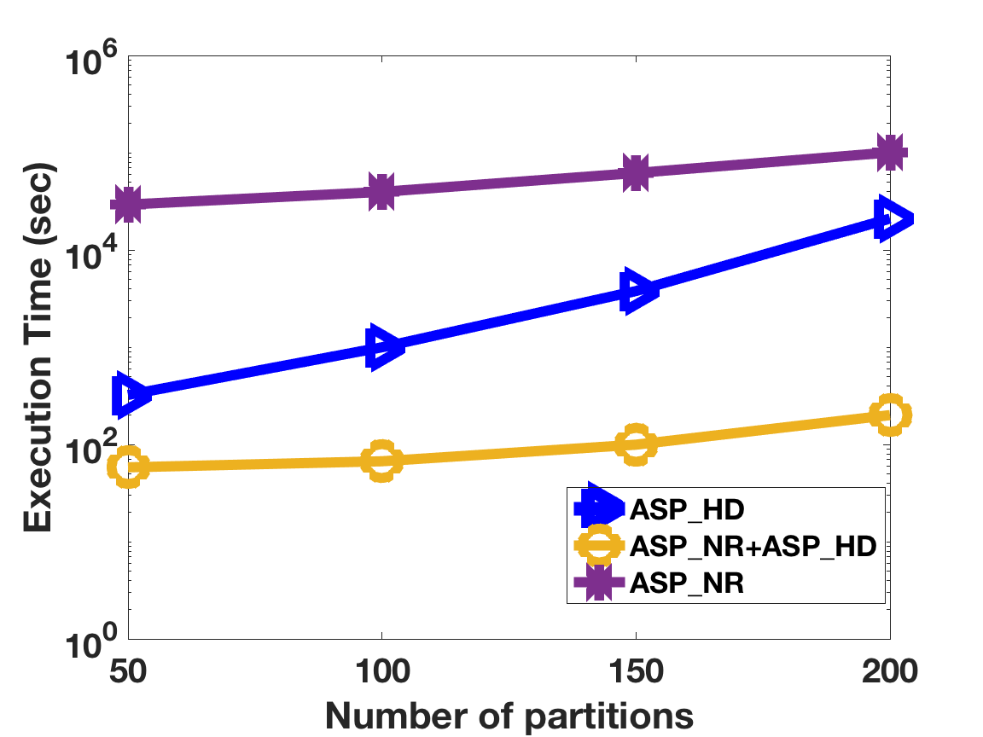
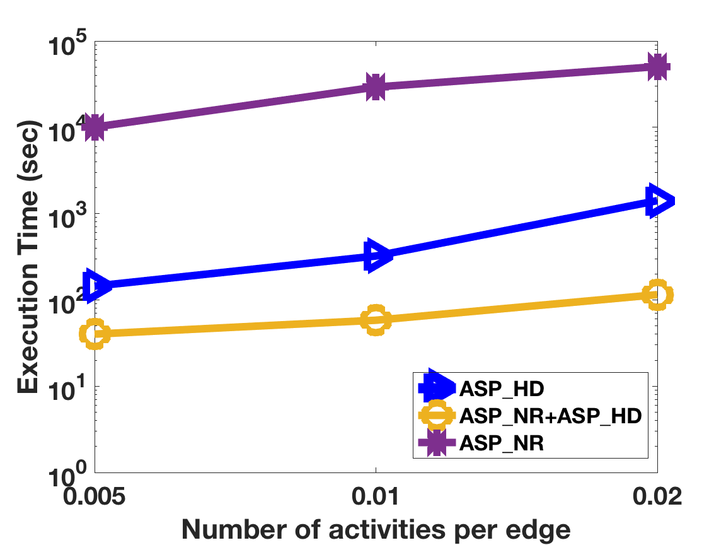
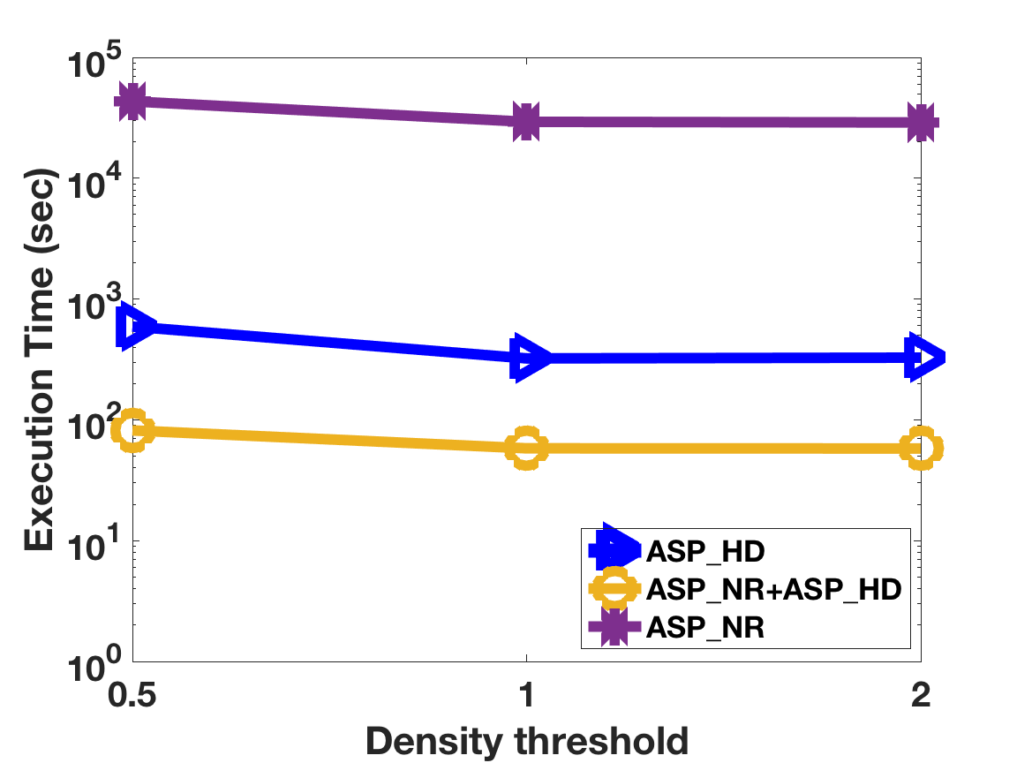
Results under other varied parameters
ASP_FMGT and ASP_FMGT_Mono
Path reduction approaches
Trends:
For ASP_FMGT and ASP_FMGT_Mono:
More partitions lead to more speedup
Higher density thresholds lead to less speedup
Higher activity densities lead to more speedup
For path reduction approaches:
More partitions lead to more speedup
Higher density thresholds lead to more speedup
Higher activity densities do not greatly affect speed up

Slide 9
Sensitivity analysis: How are proposed approaches affected by number of nodes?
Fixed Parameters:
Activity density (activity per edge in average): 0.01
Density threshold = 1
Number of partitions = 50
Varied parameter: Number of Nodes
ASP_Base, ASP_FMGT and ASP_FMGT_Mono
Path reduction approaches
Trends:
The costs of proposed approaches increase slower than baseline
ASP_FMGT_Mono

Slide 10
Sensitivity analysis: How are proposed approaches affected by varied number of partitions?
Fixed Parameters:
Activity density (activity per edge in average): 0.01
Density threshold = 1
Number of Nodes = 650 (ASP_FMGT and ASP_FMGT_Mono) , or 4000 (path reduction)
Varied parameter: Number of partitions
ASP_FMGT and ASP_FMGT_Mono
Path reduction approaches
Trends:
More partitions lead to higher cost due to (1) larger tree and (2) number of paths in cost reduction approaches
ASP_FMGT_Mono

Slide 11
Sensitivity analysis: How are proposed approaches affected by varied number of activities?
Fixed Parameters:
Number of partitions: 50
Density threshold = 1
Number of Nodes = 650 (ASP_FMGT and ASP_FMGT_Mono) , or 4000 (path reduction)
Varied parameter: Activity density (activity per edge in average):
ASP_FMGT and ASP_FMGT_Mono
Path reduction approaches
Trends:
More activities lead to higher cost due to (1) More active nodes and edges and (2) less pruning
ASP_FMGT_Mono

Slide 12
Sensitivity analysis: How are proposed approaches affected by varied density threshold?
Fixed Parameters:
Number of partitions: 50
Activity density (activity per edge in average): 0.01
Number of Nodes = 650 (ASP_FMGT and ASP_FMGT_Mono) , or 4000 (path reduction)
Varied parameter: Density threshold
ASP_FMGT and ASP_FMGT_Mono
Path reduction approaches
Trends:
Larger density threshold lead to less cost because of more pruning
ASP_FMGT_Mono

Slide 13
Outline
Motivation
Problem Statement
Challenges
Related Work
Contributions
Validation
Theoretical analysis
Experimental evaluation
Case studies
Conclusion

Slide 14
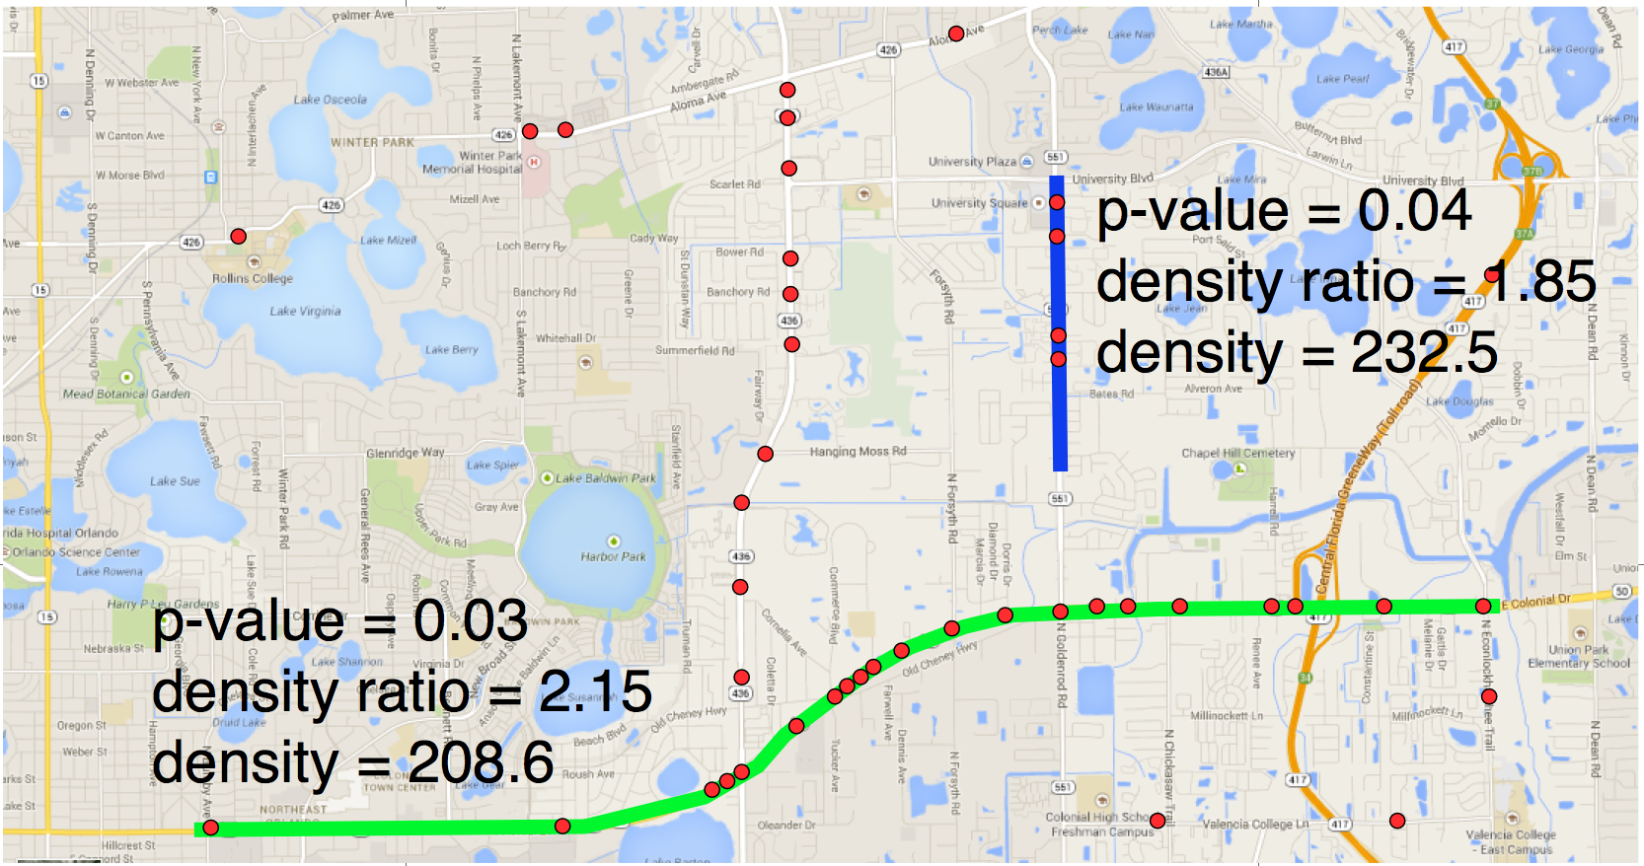
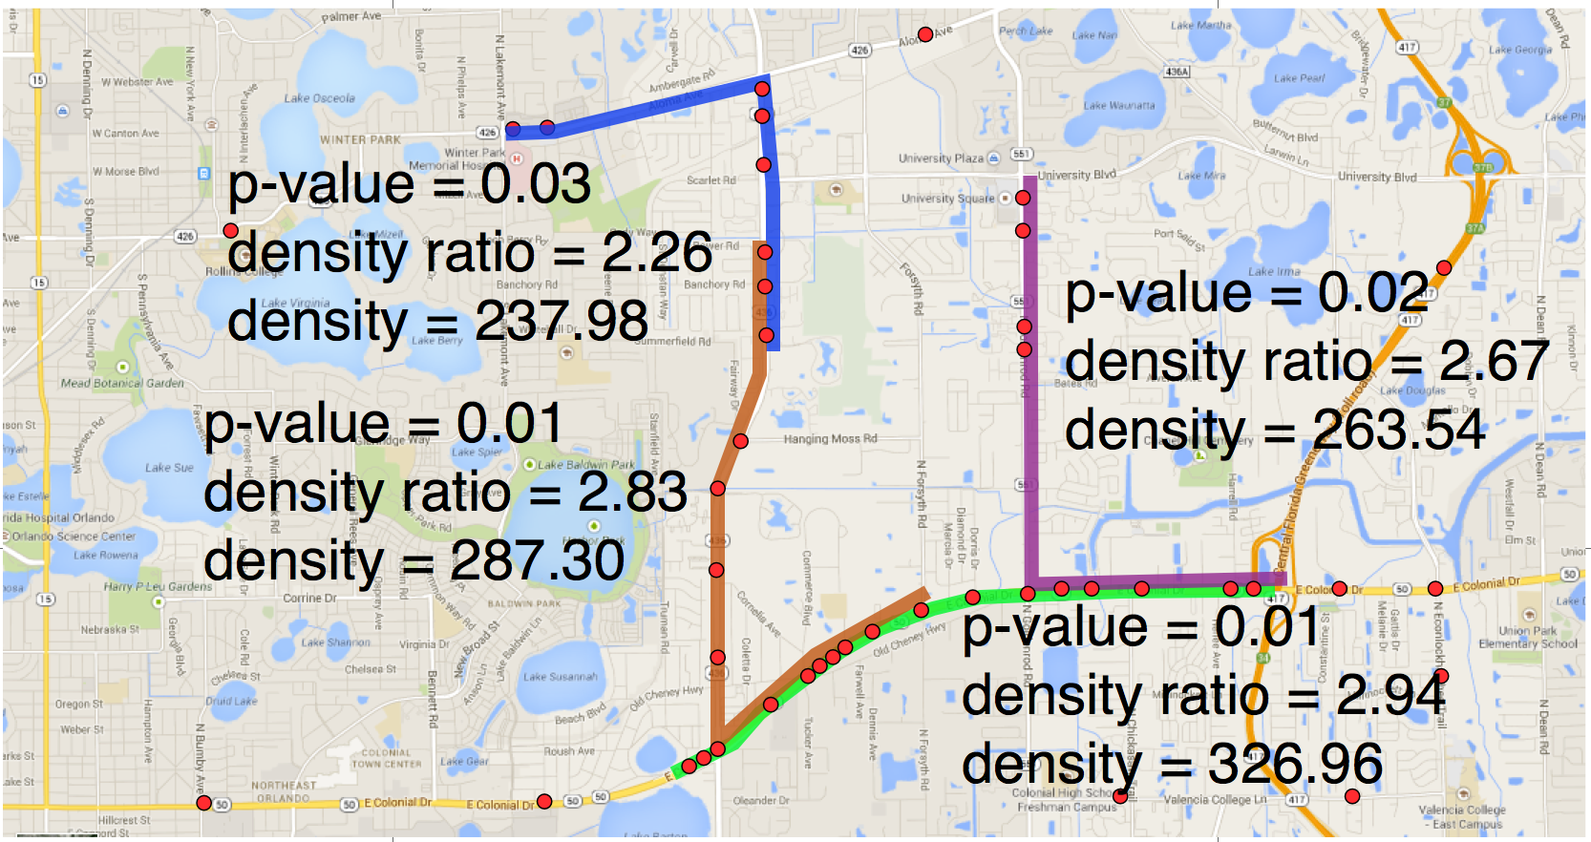
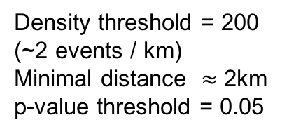
Case Study – Orlando pedestrian fatality dataset
Dataset: 43 pedestrian fatalities (represented as dots) in Orlando, Florida occurring between 2000 and 2009
Goal: Evaluate simple paths hotspots vs. shortest path hotspots and circular hotspots
Density threshold = 200 (~2 events / km)
Minimal distance $≈$ 2km
p-value threshold = 0.05
(a) Input data
(b) Result of SaTScan
(c) Result of shortest path linear hotspot detection
(based on density ratio)
(d) Result of all-simple-path linear hotspot detection (based on density)

Slide 15
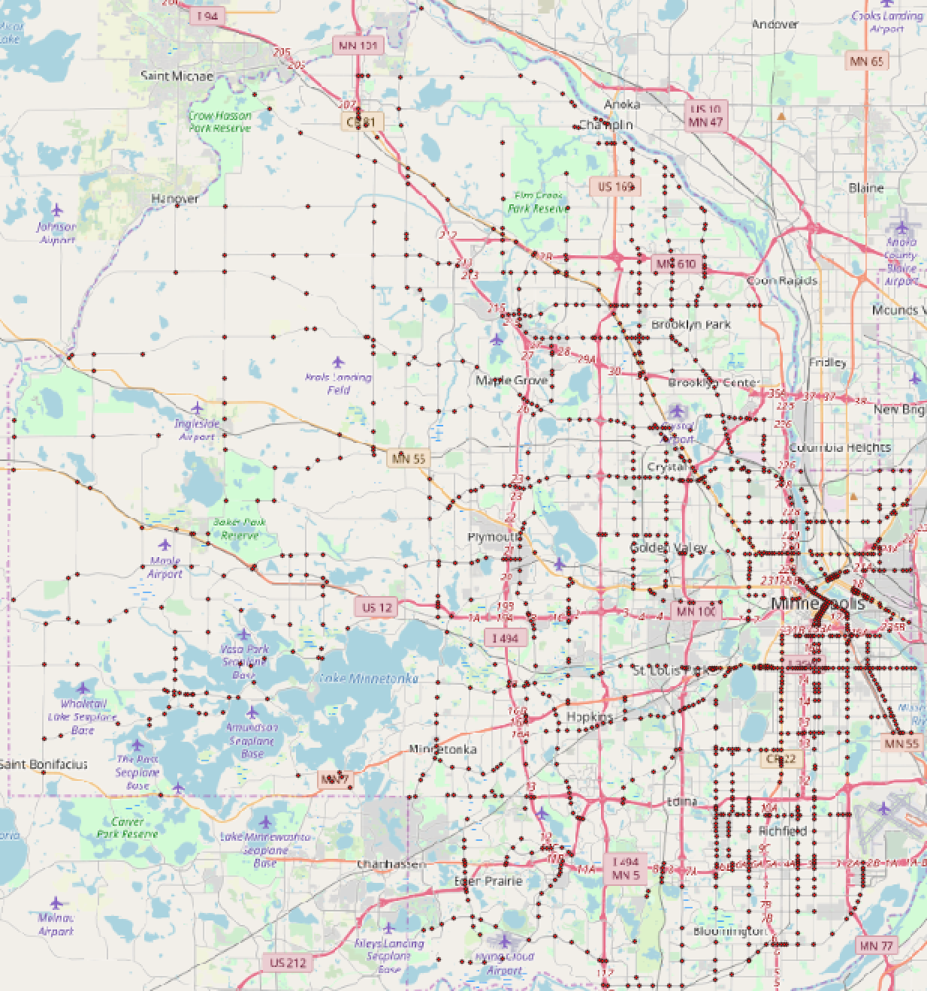
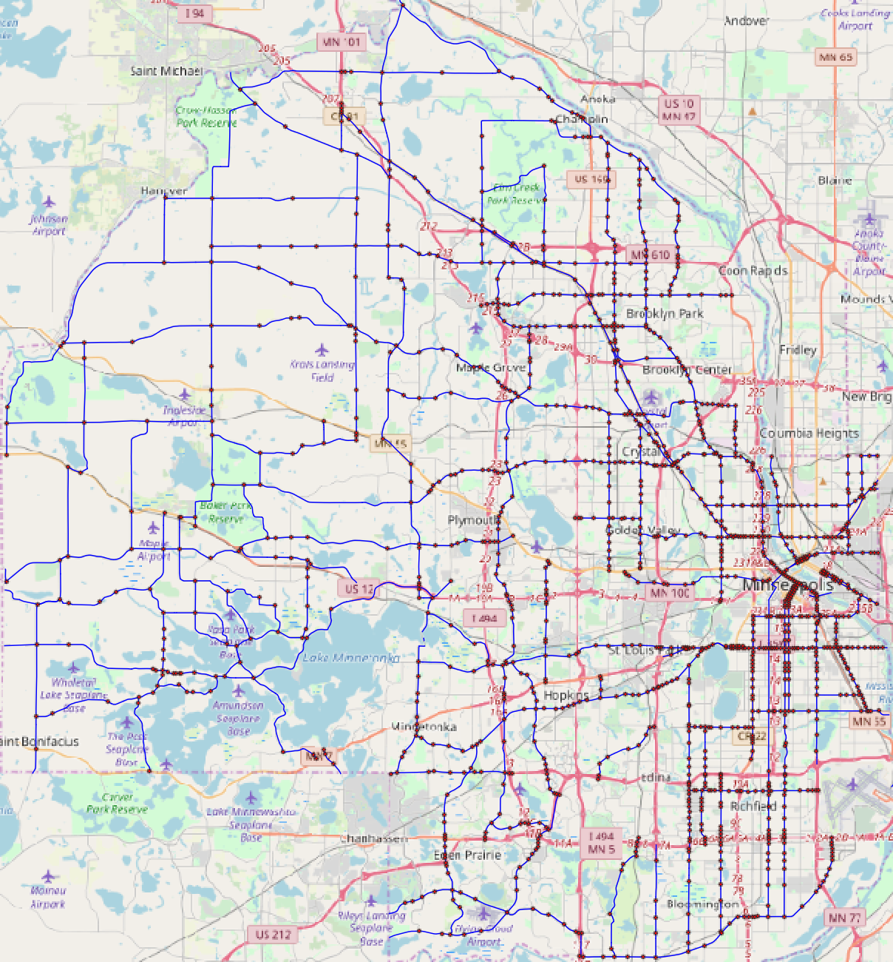
Case Study – Hennepin county traffic accident dataset - SaTScan
Dataset: 1345 crashes in Hennepin County major intersection between 2010 and 2015
Approach: SaTScan, ASP_NR + ASP_HD
Parameters: p-value threshold = 0.01, minimum distance = 800 meters, 80 fragments
p-value = 0.01
(a) Input data
(b) Hotspot detected by SaTScan
Only one huge hotspot is detected by SaTScan
(b) Result from SaTScan

Slide 16
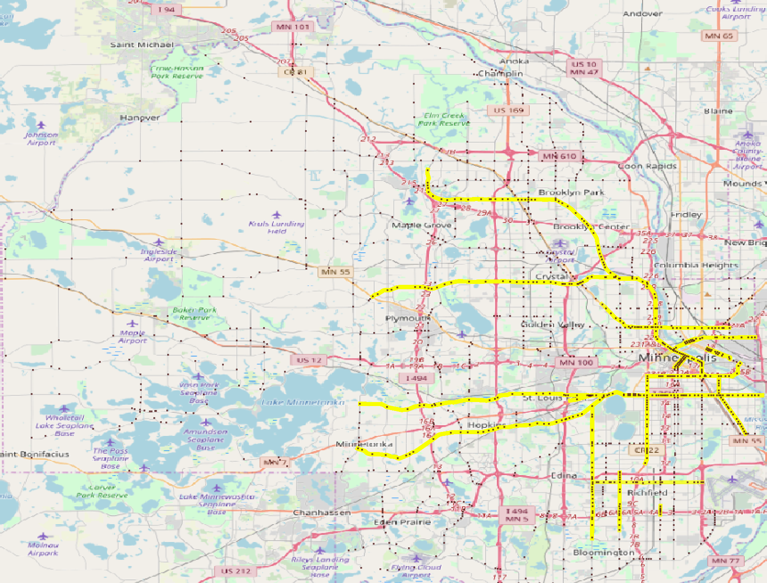
Case Study – Hennepin county traffic accident dataset – linear hotspots
Dataset: 1345 crashes in Hennepin County major intersection between 2010 and 2015
Approach: SaTScan, Shortest path linear hotspots, ASP_NR + ASP_HD
Parameters: p-value threshold = 0.03, minimum distance = 800 meters, 80 fragments, ~9000 simple paths linear hotspots are detected
Brooklyn Blvd
Washington Ave
Como Ave
Franklin Ave
Lake St
Hiawatha Ave
Shortest path linear hotspots
Simple path hotspots coverage by
ASP_NR + ASP_HD
Observation: proposed simple path hotspots detection finds more patterns

Slide 17
Outline
Motivation
Problem Statement
Challenges
Related Work
Contributions
Validation
Conclusion

Slide 18
Conclusion
Formally define the problem of Linear Hotspot Discovery on All-Simple-Paths (ASP)
Propose a baseline algorithm and several novel algorithms that substantially improve computational efficiency
Baseline approach (ASP_Base)
Depth-first-search with backtracking
Bi-directional Fragment-Multi-Graph Traversal (ASP_FMGT)
Divide-and-conquer
Mono-directional Fragment-Multi-Graph Traversal (ASP_FMGT_MONO)
Bi-directional to Mono-directional traversal
Tighter upper-bound
Non-repeated FMG-node path reduction (ASP_NR)
Highest density paths in FMG-node path reduction (ASP_HD)
Path reduction approaches
Validation:
Theoretical
Experimental
Comparative and sensitivity analyses using synthetic data
Case studies using real-world data
New after
thesis proposal

Slide 19
Future work – a taxonomy
Work in thesis
Short term future work
Long term future work
 |  | Output pattern footprint
 |  | Point | Linear |  |  | Areal
 |  |  | Shortest paths | Simple paths | All paths
Input footprint | Spatial point event |  | Linear hotspots on shortest paths | Linear hotspots on ASP Linear hotspots on near-shortest paths Multi-level hierarchy | Linear hotspots on Trajectory-aware paths
 | ST point event |  |  | Emerging hotspots on ASP | Emerging hotspots on trajectory-aware paths
 | ST linear event in trajectory |  |  | ST intersection summarization on ASP | ST intersection summarization on trajectory-aware paths | ST Intersection Statistically significant ST intersections Areal ST intersection summarization
ST: Spatio-temporal
ASP: All-simple-paths

Slide 20
Future work – short term
Linear hotspots on near-shortest paths
Balance between shortest paths and all simple paths
User-specified parameters for paths enumeration
Paths x times long of shortest paths
Number of paths x times of shortest paths
Hierarchical structure for linear hotspots detection on ASP
Potentially scalable for much larger dataset
Solve the bottleneck by reducing space cost
Statistically significant spatio-temporal intersections
Current pattern has no test statistic
Defines a test statistic that measures the likelihood of intersection as a function of
Location of missing segment
Length of missing segment
Speed of object

Slide 21
Future work – a taxonomy
Work in thesis
Short term future work
Long term future work
 |  | Output pattern footprint
 |  | Point | Linear |  |  | Areal
 |  |  | Shortest paths | Simple paths | All paths
Input footprint | Spatial point event |  | Linear hotspots on shortest paths | Linear hotspots on ASP Linear hotspots on near-shortest paths Multi-level hierarchy | Linear hotspots on Trajectory-aware paths
 | ST point event |  |  | Emerging hotspots on ASP | Emerging hotspots on trajectory-aware paths
 | ST linear event in trajectory |  |  | ST intersection summarization on ASP | ST intersection summarization on trajectory-aware paths | ST Intersection Statistically significant ST intersections Areal ST intersection summarization
ST: Spatio-temporal
ASP: All-simple-paths

Slide 22
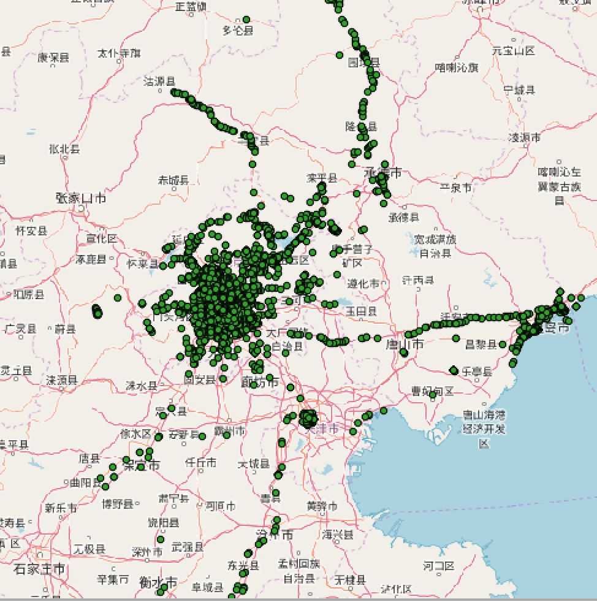
Future work – long term
Trajectory-aware linear hotspots detection
Consider paths generated from trajectory from real traffic
Avoid computation on unnecessary simple paths
May cover path with loops that are missed by all-simple paths
Spatio-temporal linear hotspots detection
Find hotspot that only appear during a period of time
Detect emerging hotspots (e.g., emerging traffic jam)
Summarization of spatio-temporal intersections
Hotspots of ST intersections
Co-location of ST intersections
…
Explore Geo-life dataset: green dots represent short GPS gaps of 1 to 2 minutes

Slide 23
References
[1] Kulldorff, M., 1999. Spatial scan statistics: models, calculations, and applications. In Scan statistics and applications (pp. 303-322). Birkhäuser, Boston, MA.
[2] Tang, X., Eftelioglu, E. and Shekhar, S., 2017, August. Detecting Isodistance Hotspots on Spatial Networks: A Summary of Results. In International Symposium on Spatial and Temporal Databases (pp. 281-299). Springer, Cham.
[3] Tang, X., Eftelioglu, E. and Shekhar, S., 2015, November. Elliptical hotspot detection: a summary of results. In Proceedings of the 4th International ACM SIGSPATIAL Workshop on Analytics for Big Geospatial Data (pp. 15-24). ACM.
[4] Oliver, Dev, et al. "Significant route discovery: A summary of results." Geographic Information Science. Springer International Publishing, 2014. 284-300.
[5] Tang, X., Eftelioglu, E., Oliver, D. and Shekhar, S., 2017. Significant Linear Hotspot Discovery. IEEE Transactions on Big Data, 3(2), pp.140-153.
[6] Eftelioglu, E., Shekhar, S., Kang, J.M. and Farah, C.C., 2016. Ring-shaped hotspot detection. IEEE Transactions on Knowledge and Data Engineering, 28(12), pp.3367-3381.
[7] Takahashi, K., Kulldorff, M., Tango, T. and Yih, K., 2008. A flexibly shaped space-time scan statistic for disease outbreak detection and monitoring. International Journal of Health Geographics, 7(1), p.14.
[8] Neill, D.B. and Moore, A.W., 2004, August. Rapid detection of significant spatial clusters. In Proceedings of the tenth ACM SIGKDD international conference on Knowledge discovery and data mining (pp. 256-265). ACM.
[9] Buchin, K., Cabello, S., Gudmundsson, J., Löffler, M., Luo, J., Rote, G., Silveira, R.I., Speckmann, B. and Wolle, T., 2009. Detecting hotspots in geographic networks. In Advances in GIScience (pp. 217-231). Springer, Berlin, Heidelberg.
[10] Oliver, D., Shekhar, S., Kang, J.M., Laubscher, R., Carlan, V. and Bannur, A., 2014. A k-main routes approach to spatial network activity summarization. IEEE transactions on knowledge and data engineering, 26(6), pp.1464-1478.
[11] Li, X., Han, J., Lee, J.G. and Gonzalez, H., 2007, July. Traffic density-based discovery of hot routes in road networks. In International Symposium on Spatial and Temporal Databases(pp. 441-459). Springer, Berlin, Heidelberg.
[12] 2014. Fatality Analysis Reporting System (FARS) Encyclopedia, NationalHighway Traffic Safety Administration (NHTSA). ftp://ftp.nhtsa.dot.gov/fars/
[13] Minnesota Department of Transportation. 2018. Minnesota Crash Mapping Analysis Tool. https://www.dot.state.mn.us/stateaid/crashmapping.html [14] Michelle Ernst, M Lang, and S Davis. 2011. Dangerous by design: solving the epidemic of preventable pedestrian deaths. Transportation for America: Surface Transportation Policy Partnership, Washington, DC. (2011).
[15] Martin Ester, Hans-Peter Kriegel, Jörg Sander, Xiaowei Xu, et al. 1996. A density- based algorithm for discovering clusters in large spatial databases with noise.. In Kdd, Vol. 96. 226–231.
[16] US Department of Transportation Federal Highway Administration. 2017. Road- way Safety Information Analysis: A Manual for Local Rural Road Owners. https://safety.fhwa.dot.gov/local_rural/training/fhwasaxx1210/s3.cfm

